Slide 1




BLEND A Fast, Memory-efficient and Accurate Mechanism to Find Fuzzy Seed Matches in Genome Analysis
Can Firtina, Jisung Park, Mohammed Alser, Jeremie S. Kim, Damla Senol Cali,
Taha Shahroodi, Nika Mansouri Ghiasi, Gagandeep Singh,
Konstantinos Kanellopoulos, Can Alkan, Onur Mutlu
Paper (NARGAB)
Source Code

Slide 2

Genome Analysis
High-throughput sequencing machines extract smaller fragments of the original DNA sequence, known as reads
Challenge: Perform genome analysis from the small random pieces of genomes
AAGCTTCCATGG
AAATGGGCTTTC
Reads
GCTTCCAGAATG
GCCCAAATGGTT
Notes:
High throughput sequencing …
[CLICK] known as reads
[CLICK] The challenge is to perform accurate and efficient genome analysis from these small random pieces
[CLICK]

Slide 3
Identifying Sequence Similarities
Mapping reads to a reference genome
Finding the potential matching locations in the genome
Identifying differences between a read and a reference genome
Reference Genome
…GCCCATATGGTTAAGCTTCCATGGAAATGGGCTTTCGCTTCCACAATG…
Differences
Differences
GCTTCCAGAATG
AAGCTTCCATGG
AAATGGGCTTTC
GCCCAAATGGTT
Notes:
We commonly use these reads to identify genomic sequence similarities in two ways.
First, we can map these reads to a previously constructed representative sequence of a species, called a reference genome.
[CLICK] Mapping reads to a reference genome helps us identify the potential matching locations of reads in the genome
[CLICK] As well as identifying the exact differences and similarities between a read and a reference genome
[CLICK]

Slide 4
Identifying Sequence Similarities
Overlapping reads to each other
Constructing assemblies
AAGCTTCCATGG
ATAAGCTTCCCT
CTGGGGGCTTTC
AGAACGTTACTT
TTTCCCAGAATG
ATGGAATGGTTC
ATAAGCTTCCCTGGGGGCTTTCCCAGAATGGAATGGTTC
De novo Assembly
Similarities must be identified efficiently
To facilitate a practical search among many sequence pairs
Notes:
The second option is to overlap reads to each other
[CLICK] Overlapping reads identifies
[CLICK] matching regions between reads
[CLICK] which then can be used to construct de novo assemblies from these overlaps.
[CLICK] These similarities must be identified efficiently and accurately to facilitate a practical genome analysis
[CLICK]

Slide 5
Practical Similarity Identification
Seeds
> 3 billion characters
Reference
…CAATTTGCCCATATGGTTAAGCTTCCATGGAAATGGGCTTTCGCTTTG…
…
K-mers
Locations
Read
GCCCAAATGGTT
GCC | 7
CCC | 8
CAA | 1
AAA | 31 | 101
CCA | 25 | 230 | 400
… | … | … | …
K-mers
GCC
CCC
…
Index (Hash Table)
Seeding
Determine potential matching regions (seeds) in the reference genome
Seed Filtering
(e.g., Chaining)
Prune some seeds in the reference genome
Alignment
Determine the exact differences between the read and the reference genome
Notes:
For example, mapping reads to reference genome usually requires expensive computation on a large number of reads
[CLICK] and a potentially very large search space. For example a human reference genome contains more than 3 billion characters.
[CLICK] Indexing the sequences enables practical search over a large database of sequences. And hash tables are commonly used data structures for indexing.
[CLICK] This index can contain some subsequences (e.g., k-mers) extracted from the reference genome, [CLICK] and the list of locations of these 𝑘-mers in the reference genome.
Identifying the sequence similarities using hash tables involves several heuristics
[CLICK] The seeding step quickly finds matching k-mers [CLICK] between a read [CLICK] and the reference genome [CLICK], which determines the regions in the reference genome potentially similar to the read
[CLICK] Chaining or seed filtering techniques enable further reducing the search space from all seed matches to a fewer regions,
[CLICK] by pruning the regions that are unlikely to be similar
[CLICK] For the remaining regions, computationally costly sequence alignment is commonly performed to identify
[CLICK] exact differences and similarities between a read and a reference genome

Slide 6
Finding Seed Matches in Hash Tables
Sequence #1:
Seeds
Sequence #2:
GCTATTACCTTAATGTGATGGAC
AGGCTATAACCCTAATGT
Hash
Hash
Hash
Hash
Hash
0x01
0xA4
0x41
0x01
0xFE
Store
Store
Store
Query
Query
Match
0x01
0xA4
0x41
Hash Table
No Match
Notes:
Let’s look more into identifying seed matches using hash tables between a pair of sequences. Here the first and second sequences can be regions from a reference genome and a read, respectively.
[CLICK] There are several sketching techniques that extract some subsequences from these sequences to find seed matches between sequences. We will call these selected subsequences seeds.
[CLICK] to efficiently identify seed matches, these seeds are hashed using a low collision hash function and
[CLICK] stored in a hash table
[CLICK] To find matching regions between these two sequence pairs, we find the seeds from the second sequence
[CLICK] hash them
[CLICK] and query the hash table using these hash values
[CLICK] This method can quickly tell us if there is a seed match or
[CLICK] not with a single lookup of hash values

Slide 7
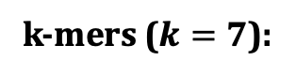
Seed Matching Techniques
Sampling the overlapping k-mers
Minimizers
Window length (w): accuracy & performance trade-off
Hash Table
k-mers ($k=7$):
GCTATTA
Hash
0xA1
Find
Min
0x02
Window:
4 k-mers
CTATTAC
Hash
0x02
TATTACC
Hash
CTATTAC
0xFC
ATTACCT
Hash
0x45
Minimizer
k-mer

Slide 8
Seed Matching Techniques
Allowing mismatches at certain positions
Spaced seeds
Choice of pattern is critical for the effectiveness of spaced seeds
GCTATTA
Pattern
GXTAXTA
Hash
0xA1
GATACTA
Pattern
GXTAXTA
Hash
0xA1
GACACTA
Pattern
GXCAXTA
Hash
0xFC
Spaced Seeds

Slide 9
Seed Matching Techniques
Allowing insertions and deletions
Linked k-mers (e.g., strobemers)
GCTATTACCTTAATGTGATGGAC
Link
GCTATTAATGGA
Hash
0xA1
GCTATCCCCTTAATGGGATGGAC
Link
GCTATTAATGGA
Hash
0xA1
GCCCTCCCCTTAAAGGGATGGAC
Link
CCTCTAAATGGA
Hash
0xFC
Selected k-mers (e.g., minimizers)
Strobemers

Slide 10
Hashing the Seeds
Seeds are hashed
To find seed matches with a direct lookup of hash values
CXCCXGG
Hash
0x0C
Hash Table
GXTAXTA
Hash
0xA1
Hash Table
GXCAXTA
Hash
0xFC
Hash Table
Spaced Seeds
Low collision hash functions
Seeds must match exactly to generate the same hash value
Advantage: Dissimilar seeds are unlikely to match
Limitation: Highly similar seeds (fuzzy seeds) are unlikely to match

Slide 11
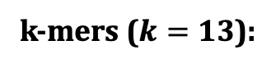
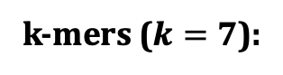
Challenges - Exact-matching seeds
Limitations when adjusting many seeding parameters
K-mer size
Window length (sampling ratio)
Determines the content of the hash table
Trade-off between performance, memory, and accuracy
k-mers ($k=13$):
k-mers ($k=7$):
GCTATTA
Hash
GCTATTACCTATG
0xA1
Window:
4 k-mers
CTATTAC
Hash
0x02
TATTACC
Hash
0xFC
Window:
7 k-mers
ATTACCT
Hash
0x45
TTACCTA
TACCTAT
ACCTATG

Slide 12
Opportunities - Fuzzy matches of seeds
A mechanism for finding fuzzy seed matches can enable
Assigning the same hash values to highly similar seeds
Different hash values for dissimilar seeds
High performance (e.g., no distance or similarity calculation) and
Space-efficient (no multiple hash functions for a single sketch) seed matching
CXCCXGG
Fuzzy
0x0C
Hash Table
GXTAXTA
Fuzzy
0xA1
Hash Table
GXCAXTA
Fuzzy
0xA1
Hash Table
Finding useful and novel seed matches that cannot be identified when finding only exact-matching seeds
Rethinking the seeding parameters to achieve better trade-off between
Performance, memory, and accuracy

Slide 13
Outline
Background
Motivation and Goal
Experimental Methodology
Temperature Analysis
Aggressor Row Active Time Analysis
Spatial Variation Analysis
Implications on Attacks and Defenses
Conclusions
Goal and Key Ideas
BLEND
Evaluation
Conclusions

Slide 14
Our Goal
Enable finding fuzzy matches of seeds
as well as exact-matching seeds
with a single lookup of hash values of seeds
Notes:
Our goal in this work is to ...

Slide 15
BLEND
Uses a hashing mechanism, SimHash, that can
generate the same hash values for similar sets
Provides the mechanisms for accurately
and efficiently converting seed sequences into
set of items

Slide 16
The SimHash Technique – Example
Goal: Generate the same hash value for similar set of items
Example input: A sentence (a set of items)
Items: Words in a sentence (hash values of items)
Count the net difference between 0s and 1s at each position
Challenge: Efficiently and accurately
convert seeds to set of items
to use with SimHash
This is an example sentence to generate a hash value
Words
This
is
an
example
sentence
to
generate
a
hash
value
Words
This
is
an
example
sentence
to
generate
a
SimHash
value
Hash Values
0b01111000
0b11011101
0b00011100
0b01000001
0b11110000
0b01011101
0b10011100
0b11000001
0b11111101
0b00101011
Hash Values
0b01111000
0b11011101
0b00011100
0b01000001
0b11110000
0b01011101
0b10011100
0b11000001
0b01001011
0b00101011
Bitwise Sum
(Net difference
between 0s and 1s)
Counter Vector
[0, +4, -2, +4, +4, 0, -8, +2]
[-2, +4, -4, +2, +4, -2, -6, +2]
SimHash Value
0b01011001
Notes:
I will briefly show how SimHash works to generate the same hash value for similar set of items
[CLICK] This is an example input that a SimHash can take as a set of items. Here the entire sentence is the set and the items of this set are
[CLICK] the words in the sentence. SimHash can generate a single hash value for the entire set
[CLICK] using the hash values of items. The hash values can be generated using a low collision hash function. Here we show the hash values in their binary form.
[CLICK] Then, to generate a single hash value, SimHash calculates the net difference of 1s and 0s at every bit position
[CLICK] and stores this difference result in a counter vector. Here we have the net difference result for each position.
[CLICK] The leftmost value shows the difference result of the most significant bit. 0 shows there are equal number of 1s and 0s
[CLICK] The rightmost is for the least significant bit. Positive values show that there are more 1s than 0s at that particular position
[CLICK] And here the negative values show there are more 0 bits than 1s
[CLICK] Then the result of this majority voting can be translated into a hash value again where each bit position is set to 1 if the corresponding position in the vector is greater than 0, meaning there are more 1s than 0s at that particular bit position in the entire set
[CLICK] By simply looking at each position in this binary, we can directly tell the majority voting result of each bit position
One important property of SimHash is when there are two highly similar sets where only a few item differs from this set, it can still generate the same hash value because the majority voting result is likely to stay the same for two similar sets although the results in the counter vector changes.
Let’s go over this using an example.
[CLICK] Here we change a single item in the set
[CLICK] and thus its hash value also changes
[CLICK] also the net difference result in the counter vector
However, the majority result of 1 and 0bits are still the same at every position so we can generate the same hash value.
[CLICK] Now the challenge is to use this nice property effectively and accurately by converting seeds into set of items.
[CLICK]

Slide 17
Outline
Background
Motivation and Goal
Experimental Methodology
Temperature Analysis
Aggressor Row Active Time Analysis
Spatial Variation Analysis
Implications on Attacks and Defenses
Conclusions
Goal and Key Ideas
BLEND
Evaluation
Conclusions

Slide 18
BLEND Overview
Goal: Efficiently find fuzzy seed matches with a single lookup
Input: A fixed-length sequence (seed sequence)
Efficiently and accurately convert the seed to its set of items
Two conversion mechanisms: BLEND-I and BLEND-S
Generate the SimHash value of the seed
Efficiently identify fuzzy seed matches by matching the SimHash values using a hash table
GCTATTAATGGA
Sequence (e.g., a strobemer seed)
Sequence to Set
Conversion:
or
Set Items
SimHash
Hash Table
0xA1
Hash Value
BLEND

Slide 19
Sequence-to-Set Conversion (BLEND-I)
Goal: Convert seed sequences into set of items
Input: A fixed-length sequence (seed sequence)
Extract all overlapping k-mers of the seed (neighbors)
Generate the hash values of neighbors using any hash function
Set items: Hash values of neighbors
GCTATTAATGGA
GCTATTAA
Hash
0b0110
All Overlapping k-mers
CTATTAAT
Hash
0b1110
Set
Items
TATTAATG
Hash
0b0111
ATTAATGG
Hash
0b1000
TTAATGGA
Hash
0b0010
Neighbors

Slide 20
Sequence-to-Set Conversion (BLEND-S)
Goal: Convert seed sequences into set of items
Input: A fixed-length sequence (seed sequence)
Extract all linked k-mers of the seed (neighbors)
Generate the hash values of neighbors using any hash function
Set items: Hash values of neighbors
GCTATTACCTTAATGTGATGGAC
Link
GCTATTAATGGA
Linked k-mers in strobemers
GCTA
Hash
0b0110
Set
Items
TTAA
Hash
0b1110
TGGA
Hash
0b0111
Neighbors

Slide 21
Generating the SimHash values
Goal: Generate the SimHash value of a seed
Input: Set items from BLEND-I or BLEND-S
Encode hash values using vectors of -1s and +1s
Bitwise sum in SimHash: Vector summation
Decode the counter vector into a SimHash value for the seed
Set Items from or
0b0110
Binary to Vector Encoding
(SIMD)
[-1, 1, 1,-1]
Sum
(SIMD)
Decoding
(SIMD)
0b1110
[ 1, 1, 1,-1]
0b0111
[-1, 1, 1, 1]
0b1000
[ 1,-1,-1,-1]
[-1, 1, 3, -3]
0b0110
Hash Table
0b0010
[-1,-1, 1,-1]
Counter Vector
Hash Value
SimHash

Slide 22
Integrating BLEND for Seeding
Sequences
Seeding + BLEND
Hash Values
Hash Table
Hash Table
GCTATTA
0x02
Find
Min
0x02
CTATTAC
0x02
TATTACC
TATTACC
0x02
ATTACCT
0x45
Finding minimizers with BLEND
GCTATTAATGGA
0xA1
Hash Table
GCTATTAATGGA
0xA1
CCTCTAAATGGA
0xA1
Strobemer seeds
Hashing strobemer seeds with BLEND

Slide 23
Outline
Background
Motivation and Goal
Experimental Methodology
Temperature Analysis
Aggressor Row Active Time Analysis
Spatial Variation Analysis
Implications on Attacks and Defenses
Conclusions
Goal and Key Ideas
BLEND
Evaluation
Conclusions

Slide 24
Evaluation Methodology
Integrated into minimap2 to perform end-to-end mapping
Real and simulated datasets from
PacBio (HiFi and CLR), ONT, and Illumina reads
Human CHM13 and HG002, Fruit fly, Yeast, and E. coli genomes
Use case 1: Read overlapping (all-vs-all overlapping)
Evaluated the accuracy, completeness, and contiguity of de novo assemblies generated from overlaps
Use case 2: Read mapping to a reference genome
Mapping accuracy from simulated reads
Structural variant calling
Notes:
Drosophila ananassae

Slide 25
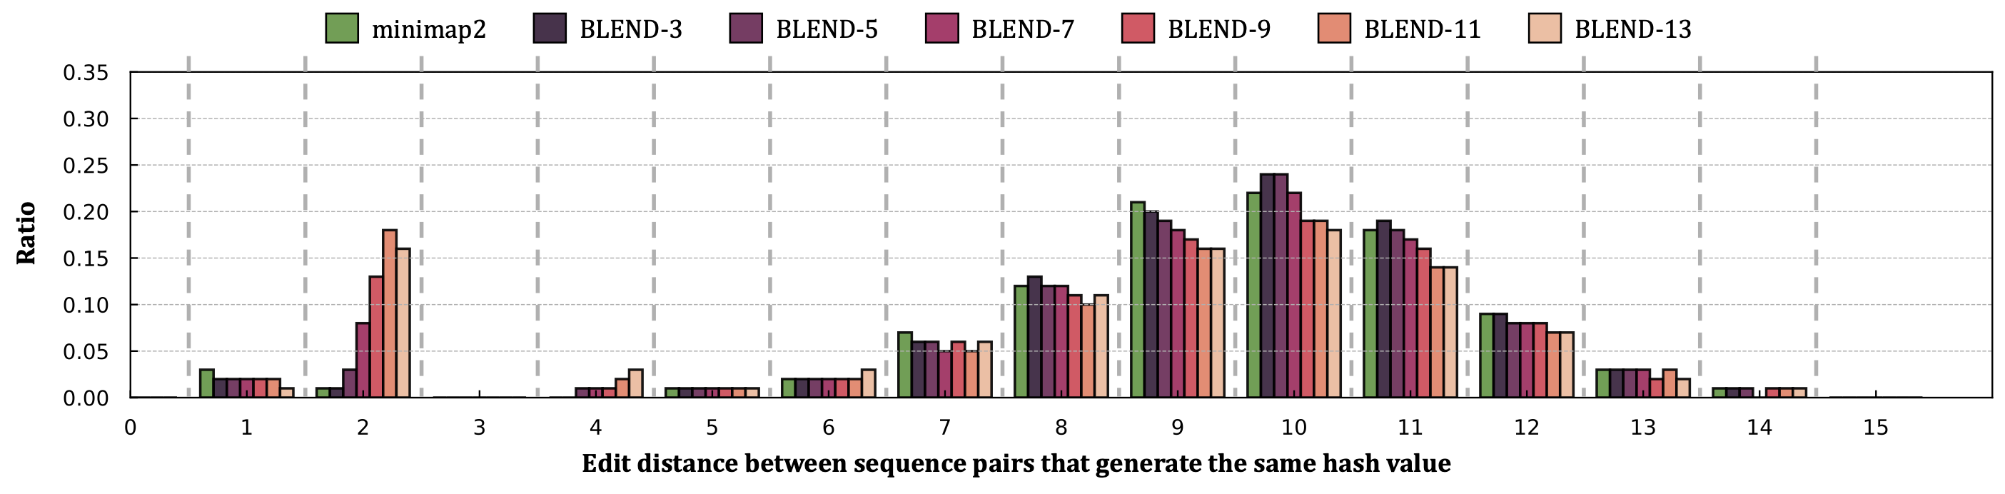
Emprical Analysis on Fuzzy Seed Matching
Non-identical minimizers with the same hash value (collision)
Edit distance between minimizer k-mers with the same hash value
Ratio of collisions with a certain edit distance using minimap2 and BLEND
Goal: Increase the collision rate for highly similar seeds
BLEND increases the collision rate for highly similar seeds
while keeping a collision rate similar to minimap2 for dissimilar seeds
Notes:
Drosophila ananassae

Slide 26
Read Overlapping – Performance & Memory
For HiFi: Average speedup of 40.3x (minimap2)
Reducing the memory footprint by 7.2x
Improving critical parameters without hurting the accuracy:
Window length (200) and seed length (31-mers)
Notes:
Drosophila ananassae

Slide 27
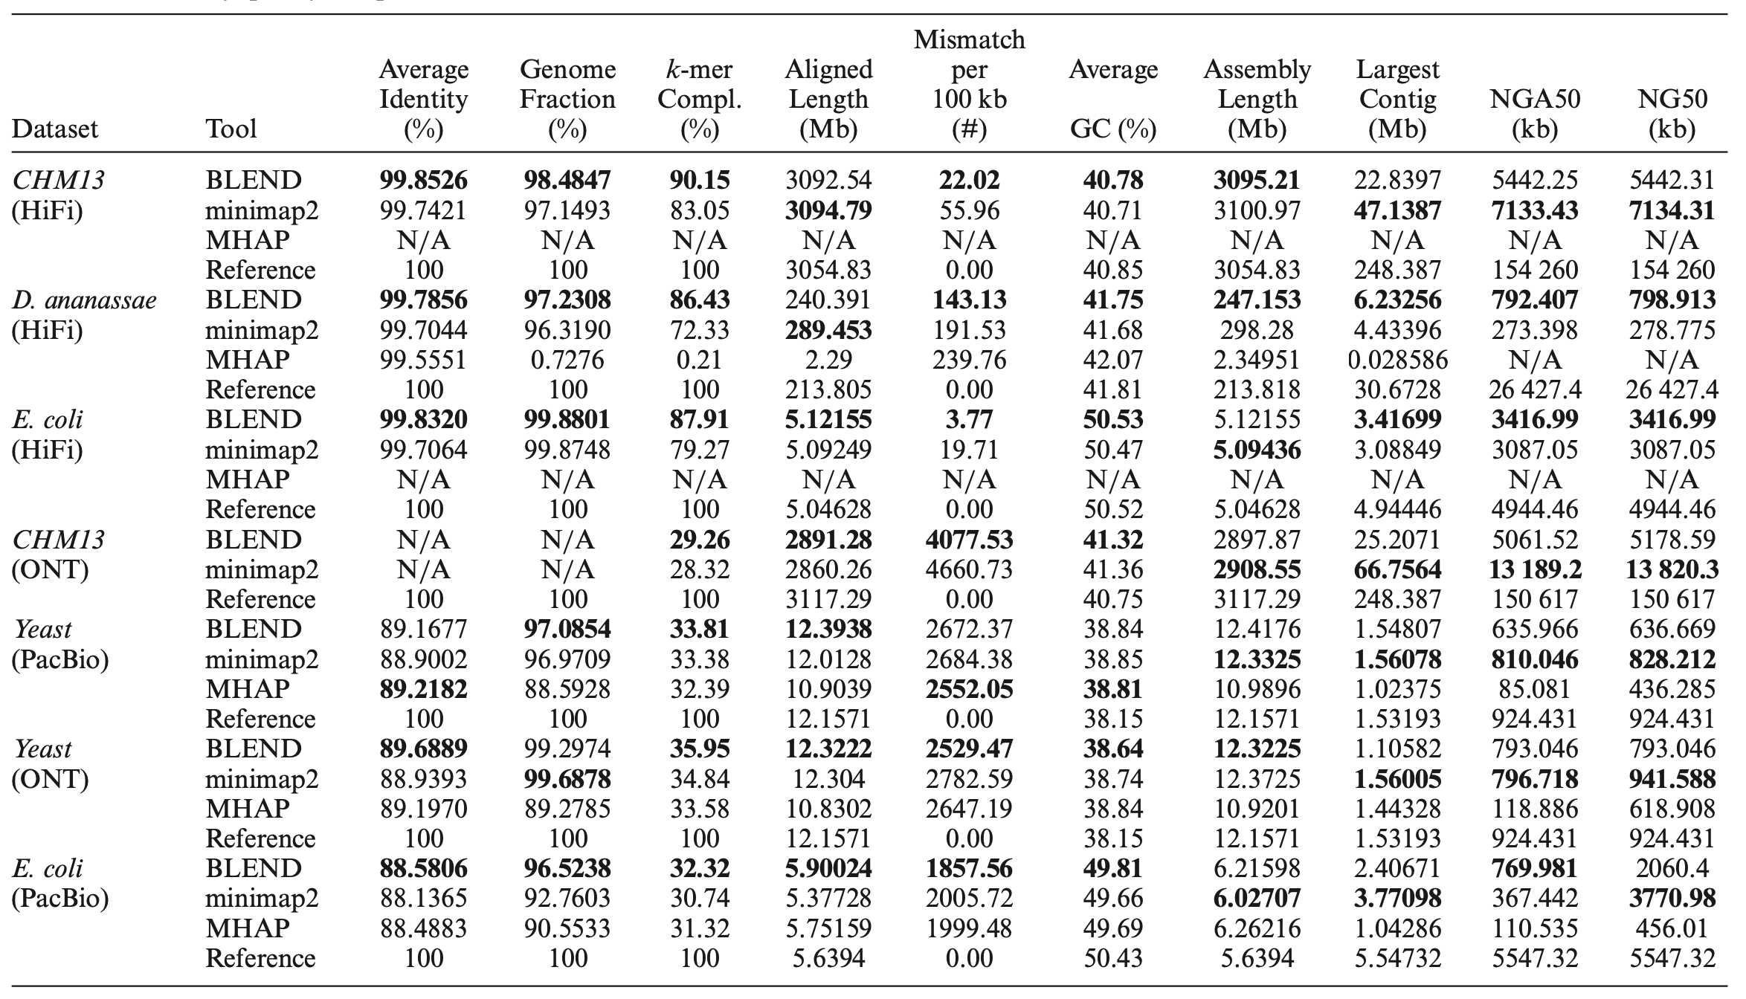
Read Overlapping – Assembly Evaluation
For HiFi: More accurate and complete assemblies
Better contiguity in most cases
Fuzzy seed matches can lead to finding novel and useful overlaps

Slide 28
Read Mapping – Performance & Memory
Average speedup of 1.7x (minimap2) and similar peak memory usage
The computational cost of sequence alignment slightly hinders
the benefits of fuzzy seed matching

Slide 29
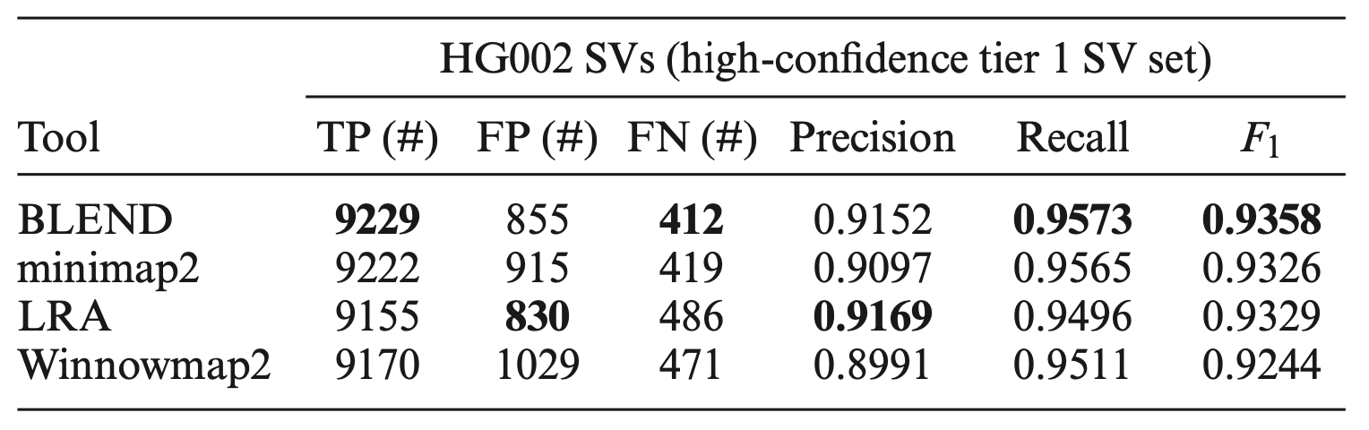
Read Mapping – SV Calling
Structural variant (SV) calling using read mappings from each tool
Sniffles2 to call SVs from HG002 long read mappings
Truvari to compare the resulting SVs with the benchmarking SV set (Tier 1 set from GIAB)
Best overall accuracy in downstream analysis

Slide 30
Outline
Background
Motivation and Goal
Experimental Methodology
Temperature Analysis
Aggressor Row Active Time Analysis
Spatial Variation Analysis
Implications on Attacks and Defenses
Conclusions
Goal and Key Ideas
BLEND
Evaluation
Conclusions

Slide 31
BLEND Summary
Problem | Finding exact-matching seeds introduce limitations in further improving the performance and accuracy of genome analysis
Goal | Enable finding the fuzzy seed matches as well as the exact-matching seeds accurately and efficiently
BLEND | Provides effective mechanisms for converting seeds into set of items to use with the SimHash technique Uses the SimHash technique to enable generating the same hash value for highly similar seeds to find fuzzy seed matches with a directly lookup of hash values
Key Results | Significant speedups and lower memory footprint especially when using HiFi reads Improves the accuracy of important applications in genome analysis

Slide 32
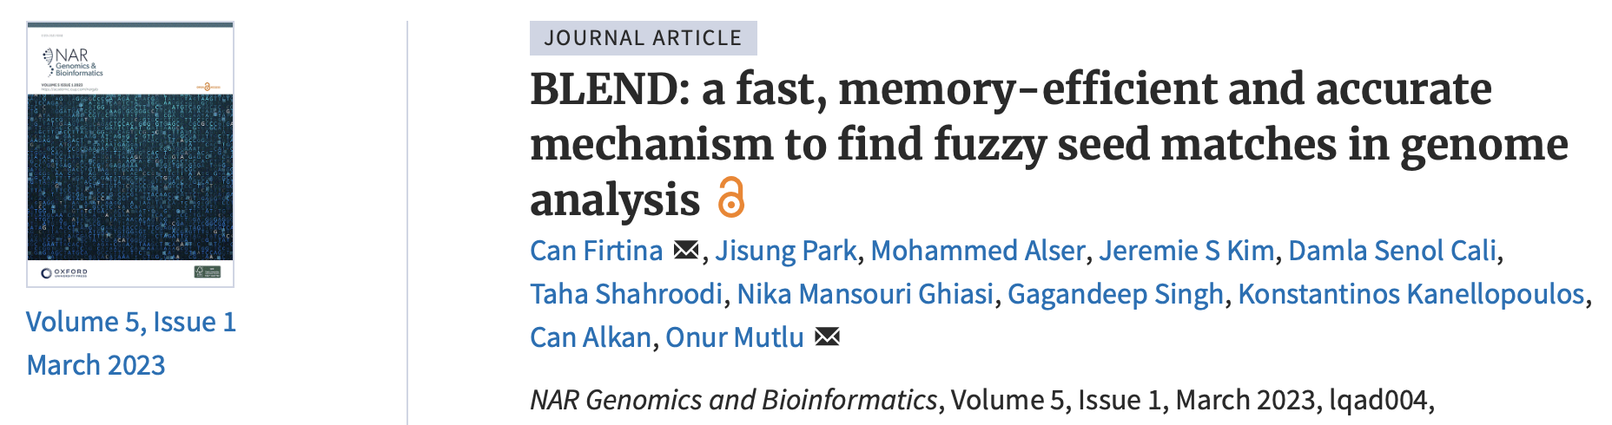
BLEND
Can Firtina, Jisung Park, Mohammed Alser, Jeremie S. Kim, Damla Senol Cali, Taha Shahroodi, Nika Mansouri Ghiasi, Gagandeep Singh, Konstantinos Kanellopoulos, Can Alkan, and Onur Mutlu, "BLEND: A Fast, Memory-Efficient, and Accurate Mechanism to Find Fuzzy Seed Matches in Genome Analysis" NAR Genomics and Bioinformatics, March 2023. [Online link at NAR Genomics and Bioinformatics Journal] [arXiv preprint] [biorXiv preprint] [BLEND Source Code]
Paper (NARGAB)

Slide 33
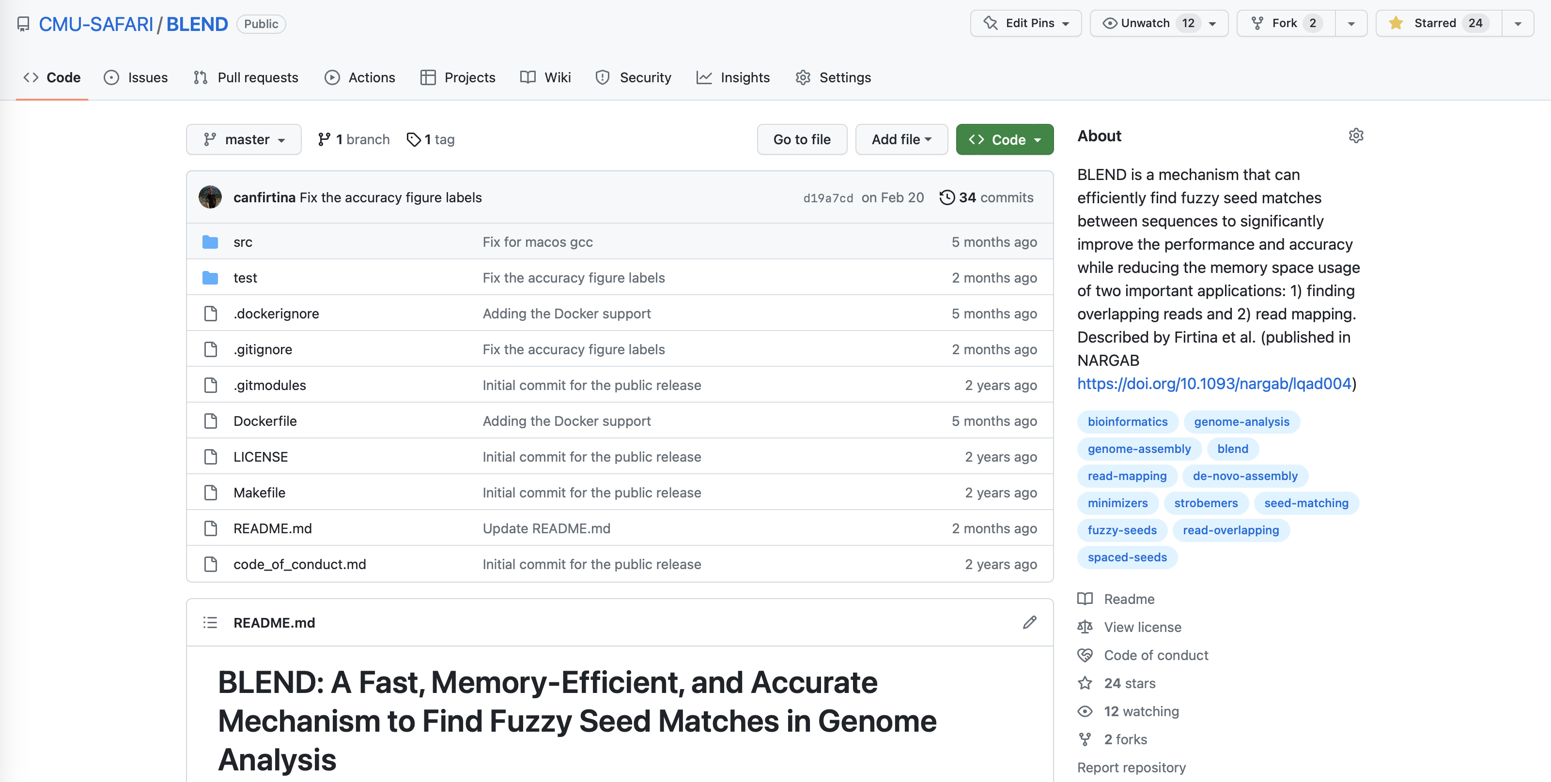
BLEND Source Code
Source Code
https://github.com/CMU-SAFARI/BLEND

Slide 34
BLEND A Fast, Memory-efficient and Accurate Mechanism to Find Fuzzy Seed Matches in Genome Analysis
Can Firtina, Jisung Park, Mohammed Alser, Jeremie S. Kim, Damla Senol Cali,
Taha Shahroodi, Nika Mansouri Ghiasi, Gagandeep Singh,
Konstantinos Kanellopoulos, Can Alkan, Onur Mutlu
Paper (NARGAB)
Source Code

Slide 35
Motivation and Goal
Experimental Methodology
Temperature Analysis
Aggressor Row Active Time Analysis
Spatial Variation Analysis
Implications on Attacks and Defenses
Conclusions
Backup Slides

Slide 36
Integrating BLEND in Read Mappers

Slide 37
Calculating SimHash using SIMD
Hash Value
(32-bit Integer)
Mask
(256-bit)
0b01…1
movemask_inverse
00…010…0…10…0
Mask
(256-bit)
00…010…0…10…0
All 1s
(32 x 8-bit Integers)
Encoded Hash Value
(32 x 8-bit Integers)
Counter Vector
(32 x 8-bit Integers)
_mm256_blendv_epi8
_mm256_adds_epi8
1,1,1,…1,1,1
1, -1, …, -1
4, -3, …, 0
All -1s
(32 x 8-bit Integers)
3, -2, …, 1
Counter Vector
(32 x 8-bit Integers)
-1,-1,-1,…-1,-1-,1
Counter Vector
(32 x 8-bit Integers)
Hash Value
(32-bit Integer)
-3, 4, -1…, 1
_mm256_movemask_epi8
0b101…0

Slide 38
Encoding Hash Values into Vectors using SIMD
Hash Value
(32-bit Integer)
Mask (256-bit)
Mask (256-bit)
All 1s
All -1s
Encoded Hash Value
(32 x 8-bit Integers)
(32 x 8-bit Integers)
0
0
0
1
0
1
-1
0
All 0
1
0
1
-1
-1
8-bit block allocation for each bit of hash value
0
1
1
0
1
-1
-1
0
All 0
0
1
1
0
movemask_inverse
32 x 8-bit
32 x 8-bit
_mm256_blendv_epi8
32-bit
32 x
32 x
32-bit
1
0
0
0
All 0
0
0
0
1
1
-1
1
0
1
0
All 0
1
-1
-1
0

Slide 39
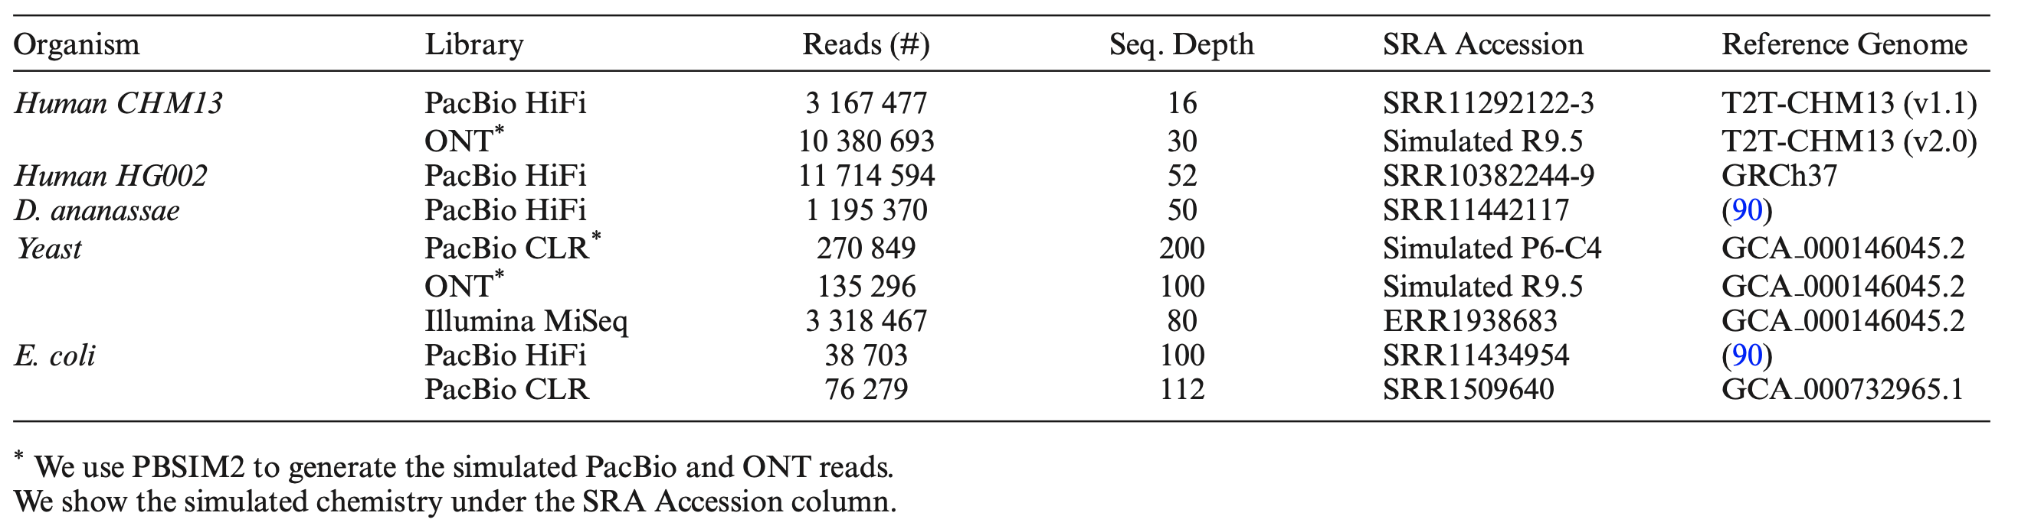
Dataset

Slide 40
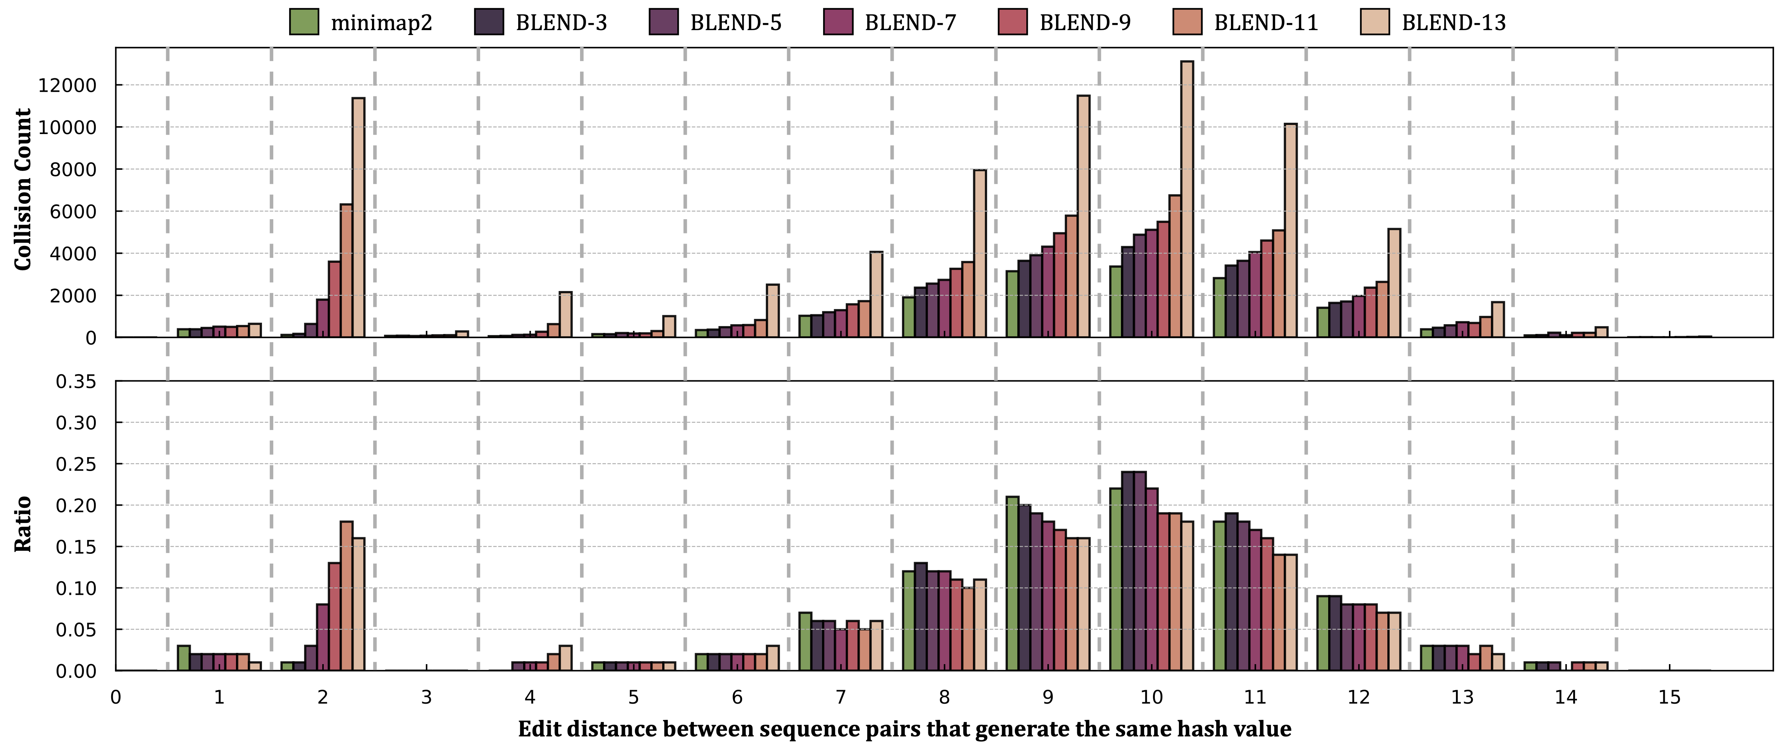
Emprical Analysis on Fuzzy Seed Matching
Minimizer collisions and the edit distance between collisions
BLEND increases the collision rate for highly similar seeds
while keeping a collision rate similar to minimap2
for dissimilar seeds
Notes:
Drosophila ananassae

Slide 41
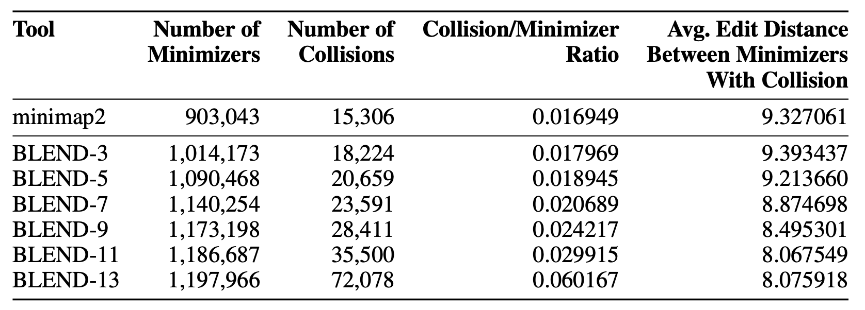
Finding Fuzzy Seed Matching between Minimizers

Slide 42
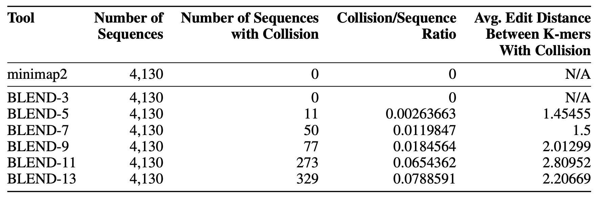
Finding Fuzzy Seed Matching between Similar Sequences

Slide 43
Read Overlapping – Assembly Accuracy

Slide 44
Read Mapping – Mapping Accuracy

Slide 45
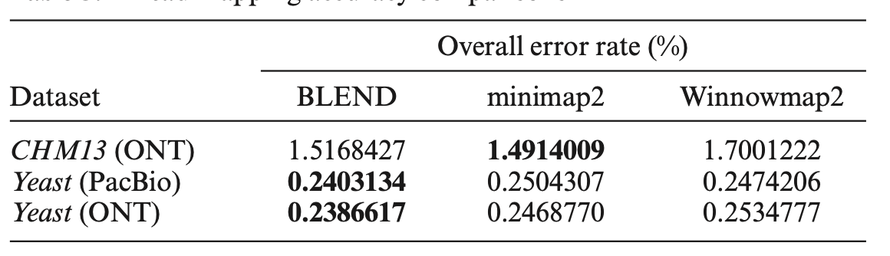
Read Mapping – Mapping Accuracy

Slide 46
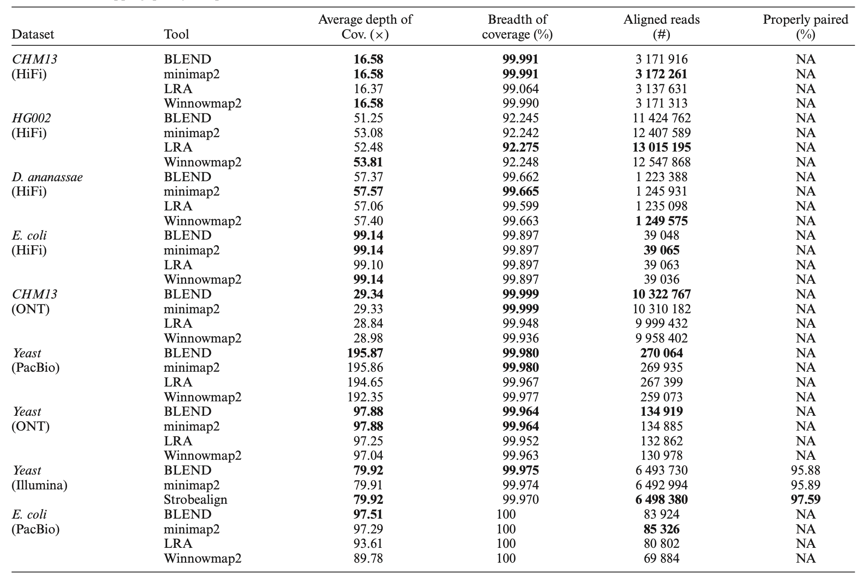
Read Mapping Quality

Slide 47
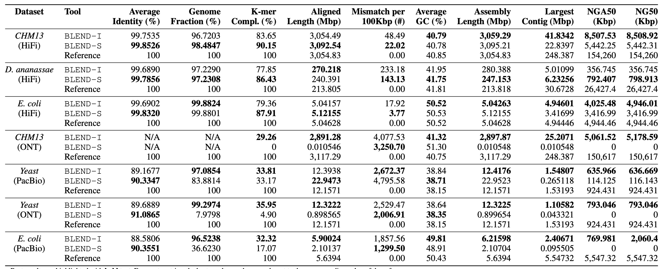
BLEND-I vs. BLEND-S (Accuracy)

Slide 48
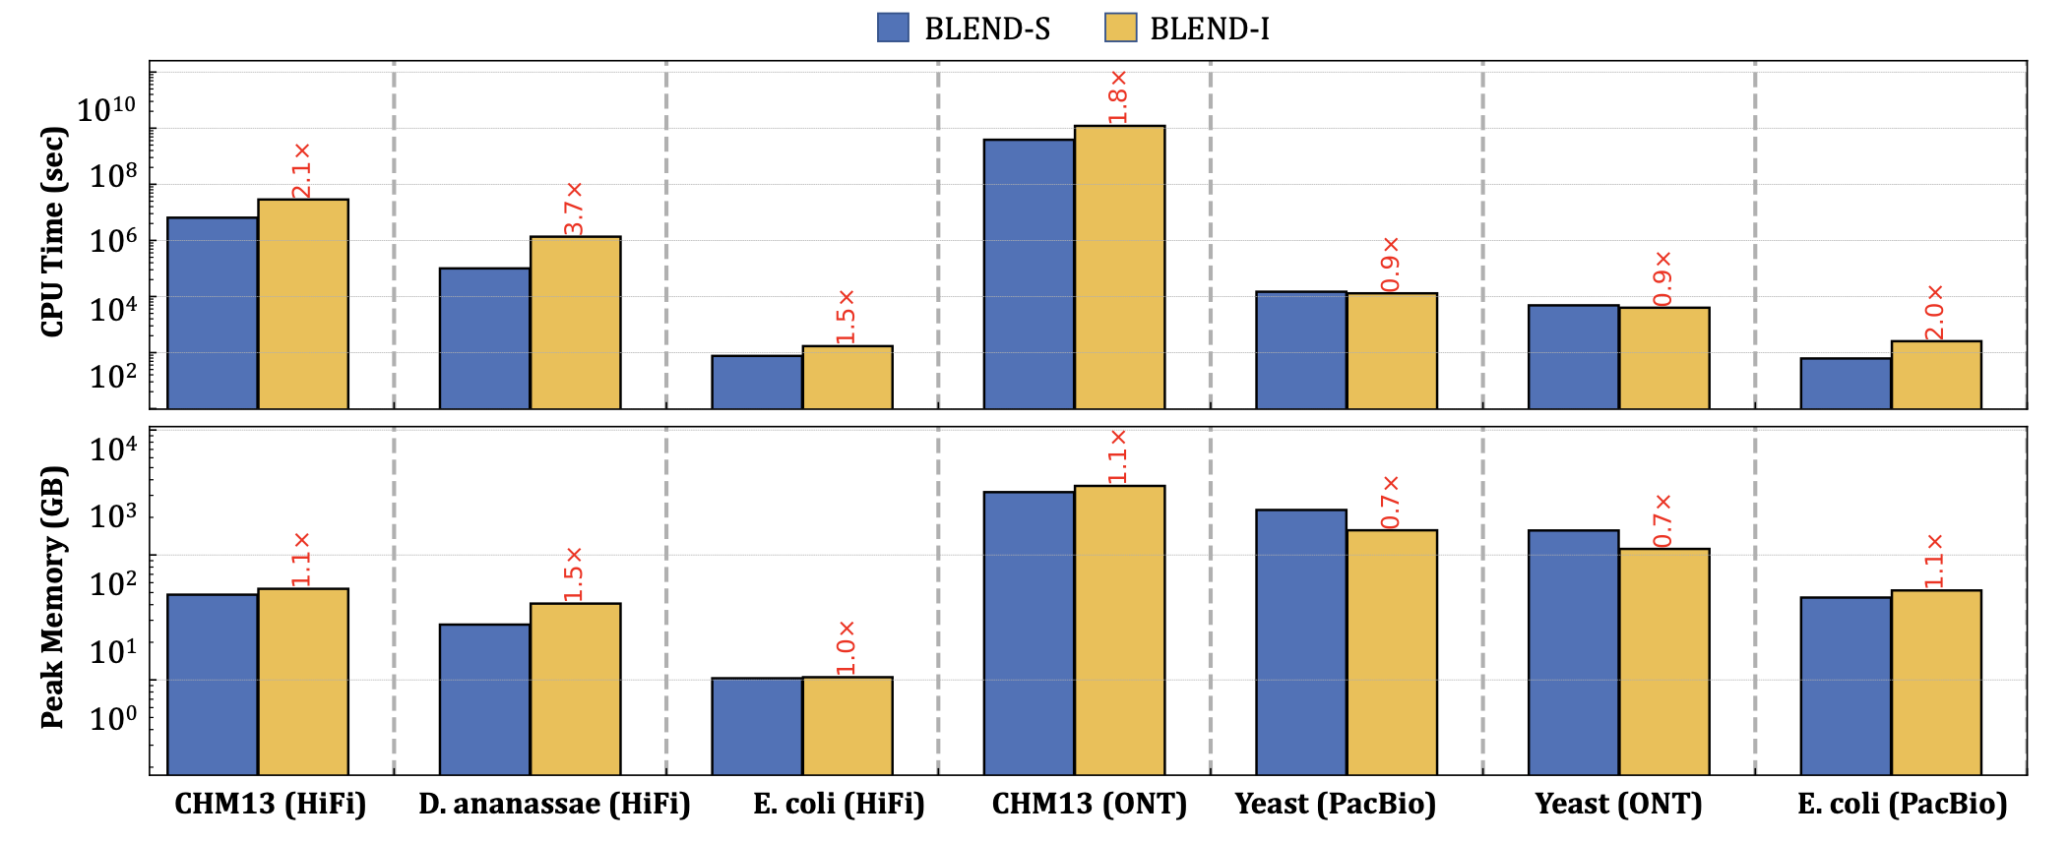
BLEND-I vs. BLEND-S (Performance and Memory)

Slide 49
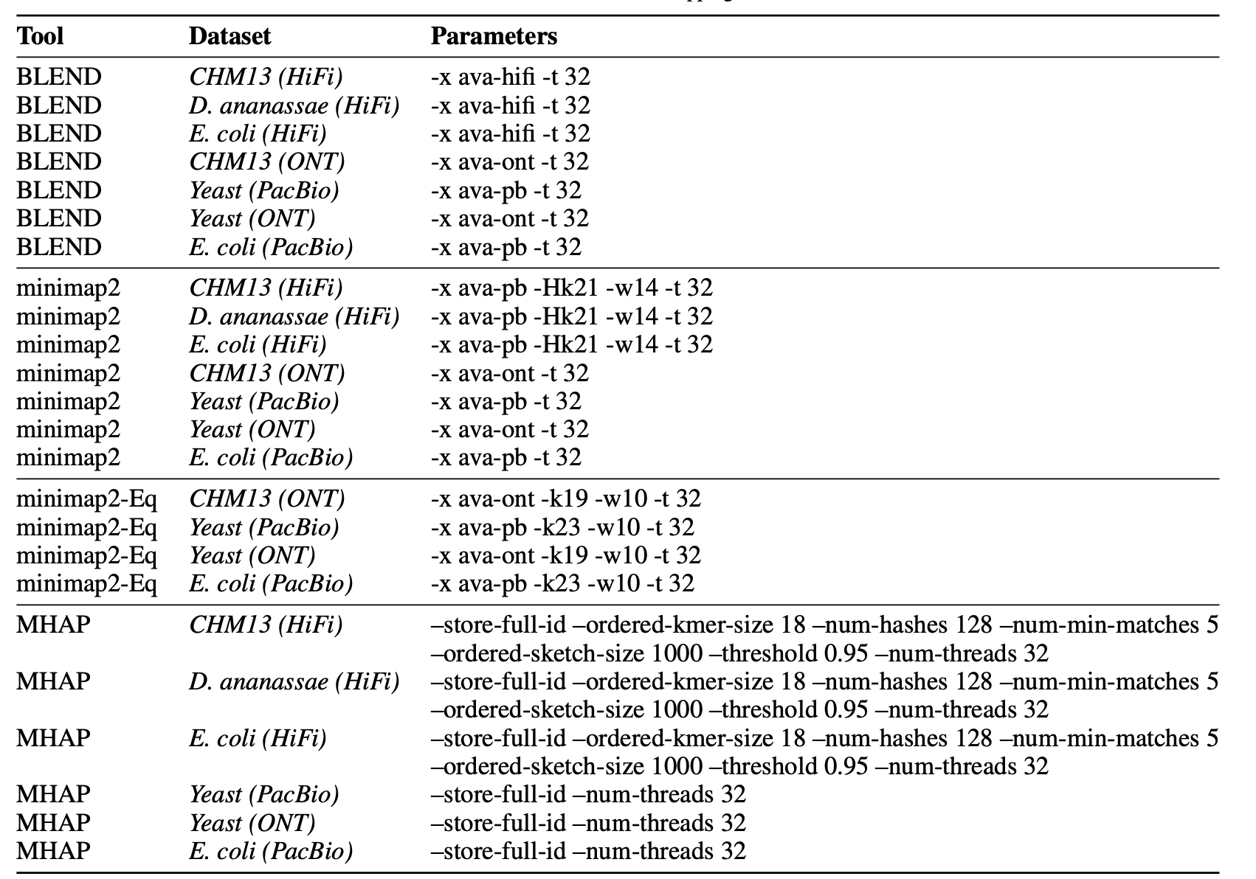
Read Overlapping Parameters

Slide 50
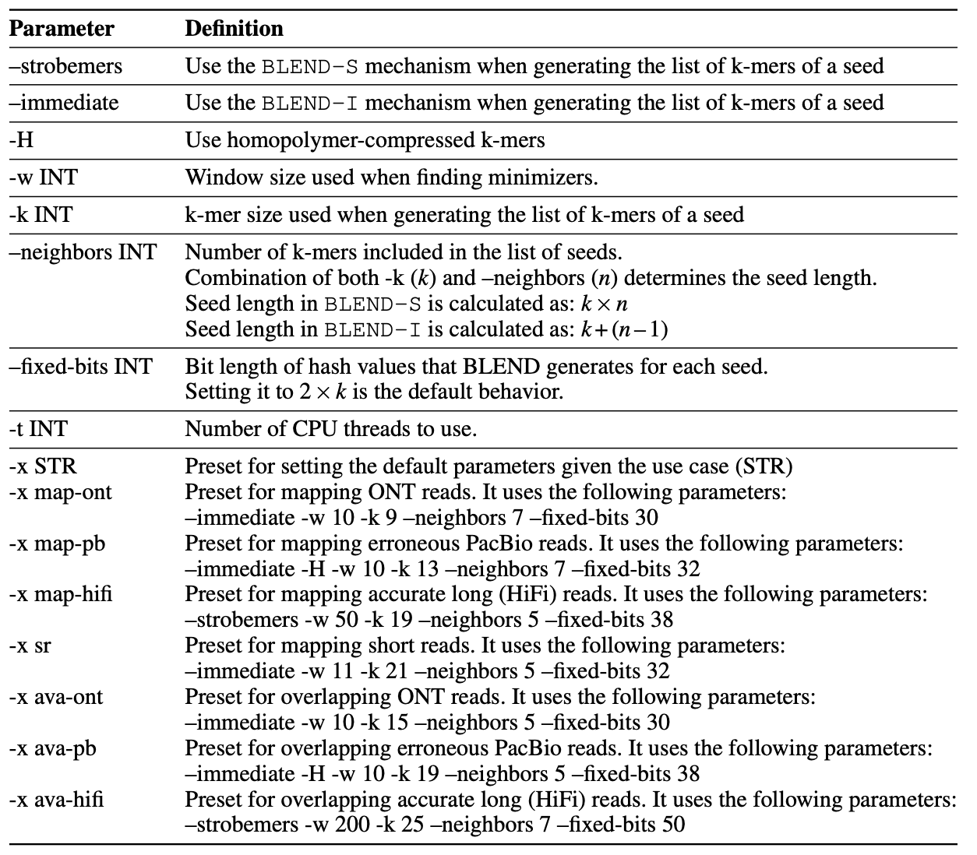
BLEND Parameter Definitions

Slide 51
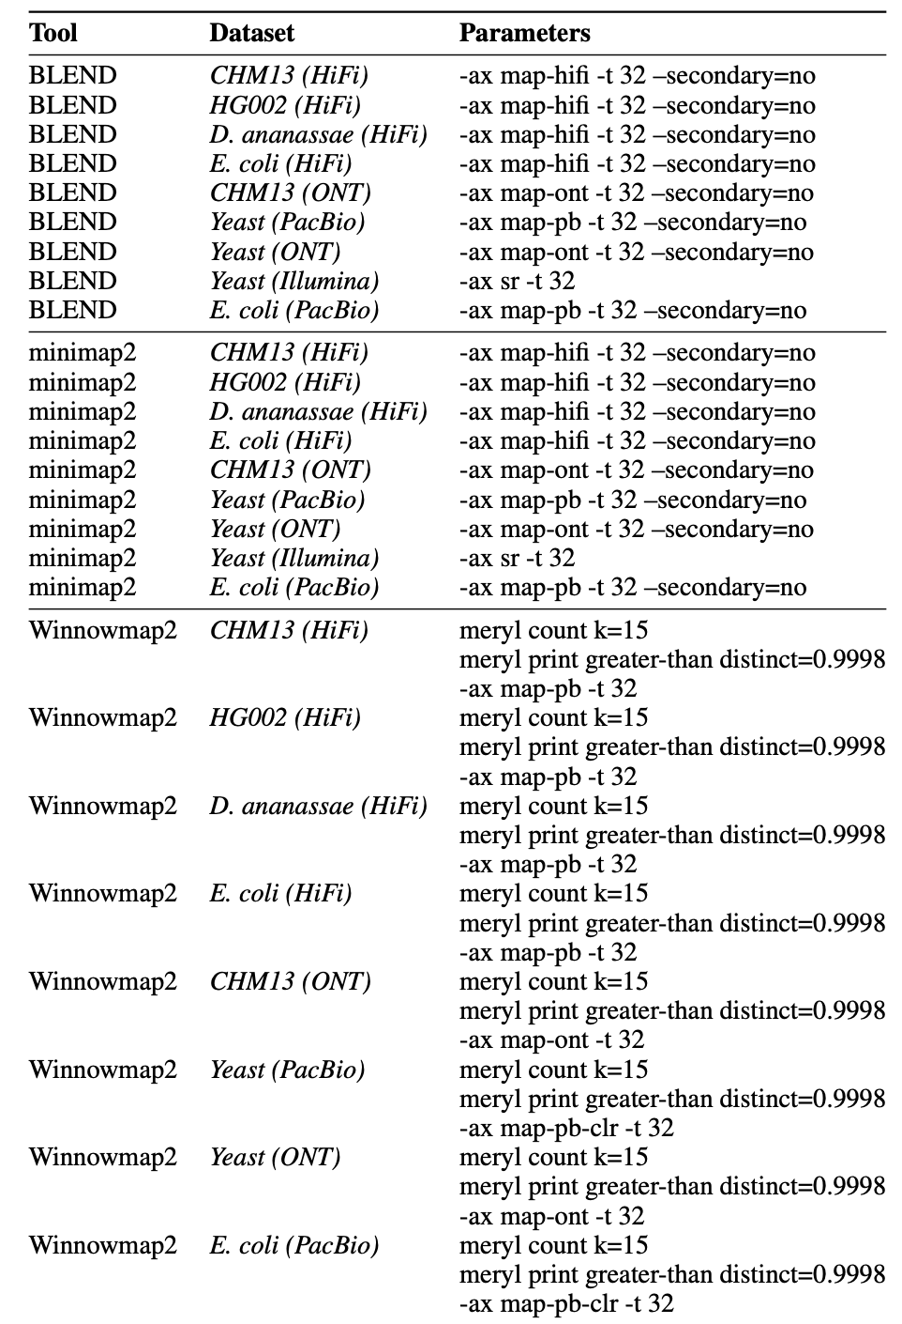
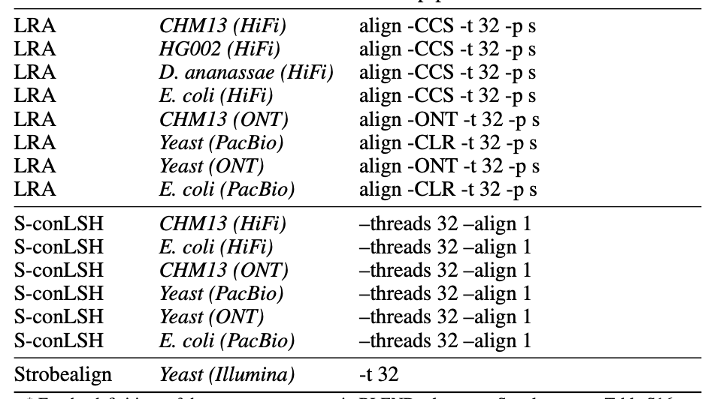
Read Mapping Parameters

Slide 52
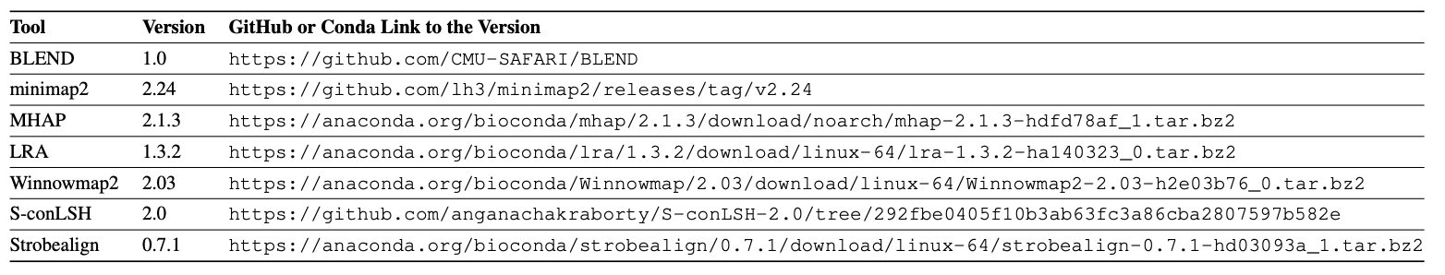
Versions of each Tool

Slide 53
BLEND Backup Slide

